Slide 1


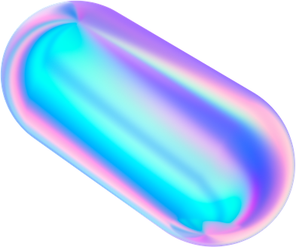

Aidan
Curry Club Quiz
06 MAY 2020

Slide 2




The 'C' round
Five questions all in categories beginning with 'C'
Chemistry
Cycling
Colwall
Classical Music
Curry

Slide 3

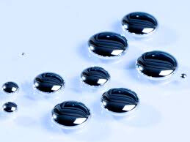

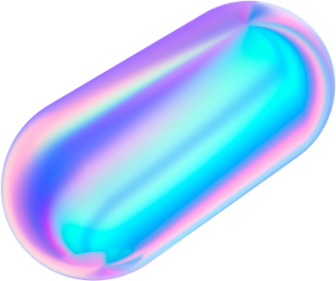
Chemistry 1 of 5
What is the chemical symbol for Mercury?

Slide 4
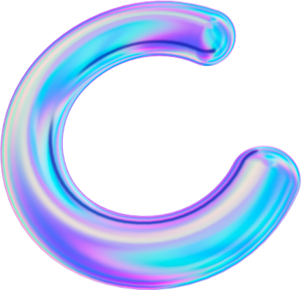

Cycling 2 of 5
A. 1883
B. 1893
C. 1903
MULTIPLE CHOICE
D. 1913
In which year was the Tour de France first held?

Slide 5
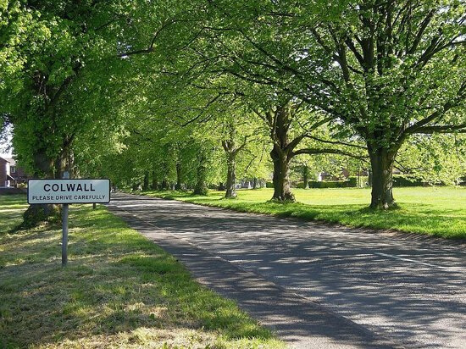
Colwall 3 of 5
At the last census in 2011 what was the population of Colwall? Give you 100 either way.

Slide 6
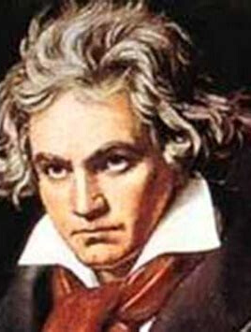
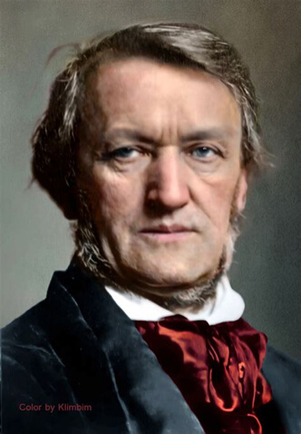
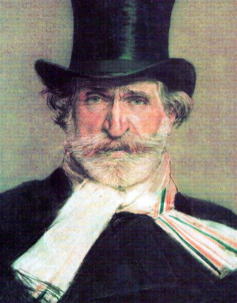
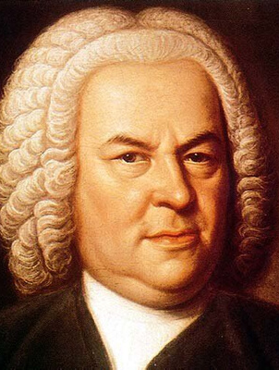
Classical Music 4 of 5
Which of these portraits is of Richard Wagner?
A
B
C
D

Slide 7
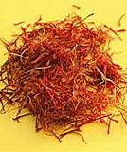
Curry 5 of 5
A. Allium Sativum
B. Myristica Fragans
C. Capsicum Annuum
MULTIPLE CHOICE
D. Crocus Sativus
What is the botanical name for Saffron?

Slide 8
Aidan
Curry Club Answers
06 MAY 2020

Slide 9
Chemistry 1 of 5
What is the chemical symbol for Mercury?
Hg
From Latin Hydragyrum for 'Quick Silver'

Slide 10
Cycling 2 of 5
A. 1883
B. 1893
C. 1903
C. 1903
MULTIPLE CHOICE
D. 1913
In Which year was the Tour de France first held?

Slide 11
Colwall 3 of 5
At the last census in 2011 what was the population of Colwall? Give you 100 either way
2400
- https://wikishire.co.uk/wiki/Colwall

Slide 12
Classical Music 4 of 5
Which of these portraits is of Richard Wagner?
A
B
C
D
Beethoven
Wagner
Verdi
J.S. Bach

Slide 13
Curry 5 of 5
A. Allium Sativum
- Garlic
B. Myristica Fragans
- Nutmeg
C. Capsicum Annuum
- Paprika
MULTIPLE CHOICE
D. Crocus Sativus
- Saffron
What is the botanical name for Saffron?

Slide 14
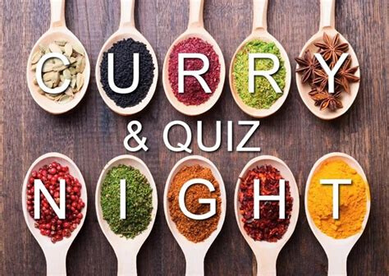
1. Hg
That's all folks
Here are the answers again:
2. 1903
3. 2400
4. Picture B
5. Crocus Sativus

